Slide 1
The Study of Financial Fraud Detection Using Classification
Jiahui Wu & Jinjie Liu
Master's Students, Cleveland State University
Summer17 CIS 660 Data Mining and Big Data Processing

Slide 2
Significance
Recent years there has been increased interests in financial fraud detection and prevention. However, it becomes even more difficult for analysts to sift through the data using conventional means.
To build detection/prediction models for financial fraud using different machine learning algorithms, and to compare their performances.

Slide 3
Project Overview
Data Analysis
Data Preprocessing
Feature Selection
Classifiers
Logistic Regression
Decision Tree
Neural network
Model Evaluation
Naive Bayes
Support Vector Machine
K-nearest Neighbors

Slide 4
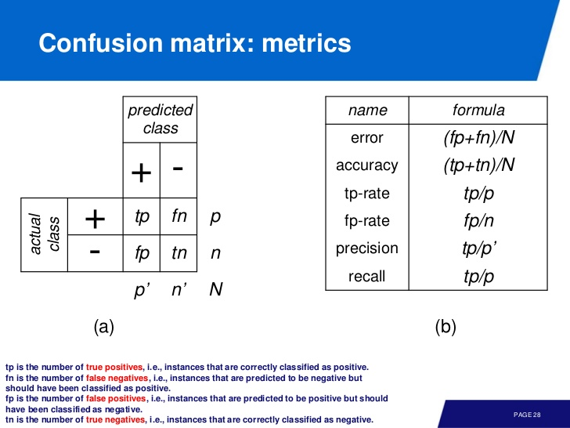

Slide 5
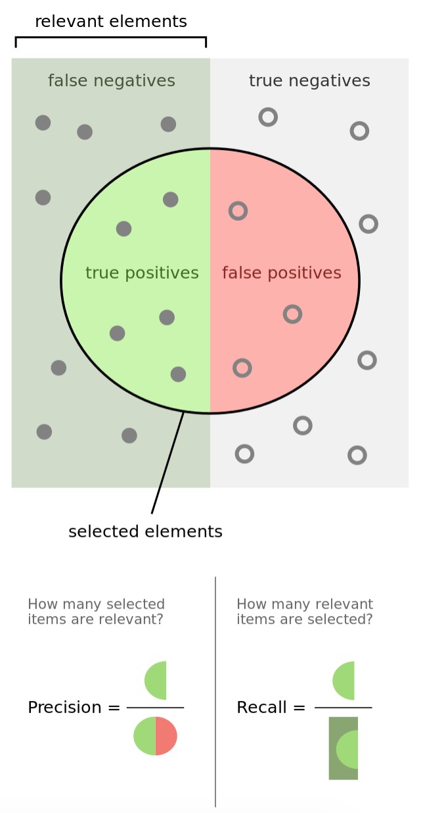
Notes:
A confusion matrix is a table that is often used to describe the performance of a classification model (or "classifier") on a set of test data for which the true values are known.
recall(also known as sensitivity) is the fraction of relevant instances that have been retrieved over total relevant instances in the image.

Slide 6
Data feature explanation
This is a sample of 1 row with headers explanation:
1,PAYMENT,1060.31,C429214117,1089.0,28.69,M1591654462,0.0,0.0,0,0
step - maps a unit of time in the real world. In this case 1 step is 1 hour of time. Total steps 744 (30 days simulation).
type - CASH-IN, CASH-OUT, DEBIT, PAYMENT and TRANSFER.
amount - amount of the transaction in local currency.
nameOrig - customer who started the transaction
oldbalanceOrg - initial balance before the transaction
newbalanceOrig - new balance after the transaction
nameDest - customer who is the recipient of the transaction
oldbalanceDest - initial balance recipient before the transaction. Note that there is not information for customers that start with M (Merchants).
newbalanceDest - new balance recipient after the transaction. Note that there is not information for customers that start with M (Merchants).
isFraud - This is the transactions made by the fraudulent agents inside the simulation. In this specific dataset the fraudulent behavior of the agents aims to profit by taking control or customers accounts and try to empty the funds by transferring to another account and then cashing out of the system.
isFlaggedFraud - The business model aims to control massive transfers from one account to another and flags illegal attempts. An illegal attempt in this dataset is an attempt to transfer more than 200.000 in a single transaction

Slide 7
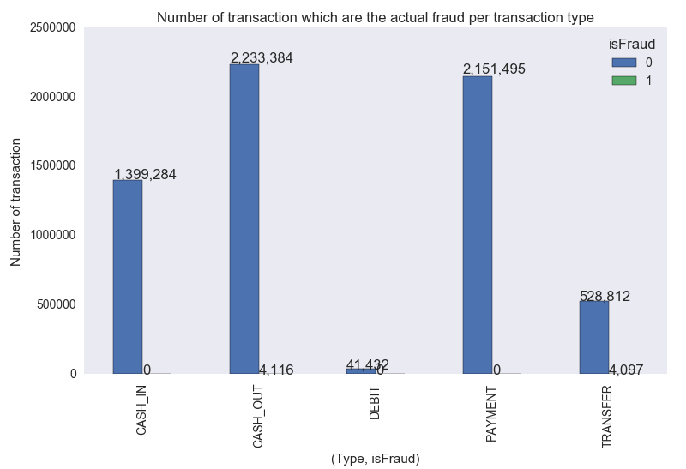
Data categorized by type and isFraud

Slide 8
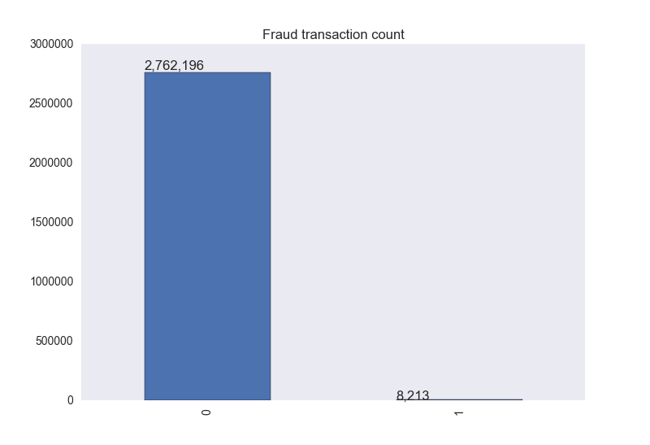
Normal and Fraud Data

Slide 9
Feature Selection
dataset
Selecting Data mining tools
Data retrieving and preprocessing
Feature selection
Classification algorithm
knn
C50
CART
Results and evaluation

Slide 10
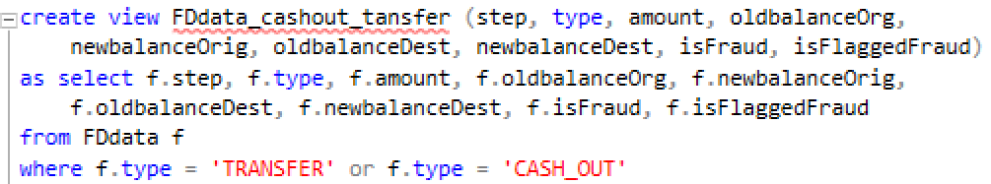
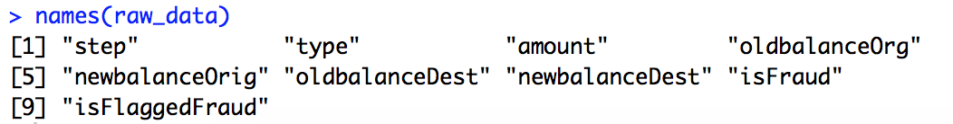
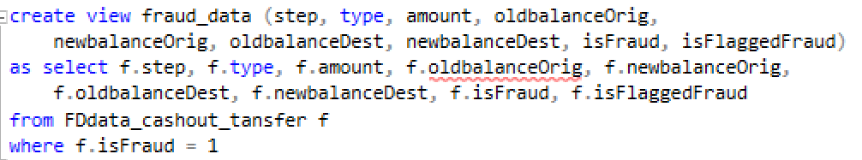
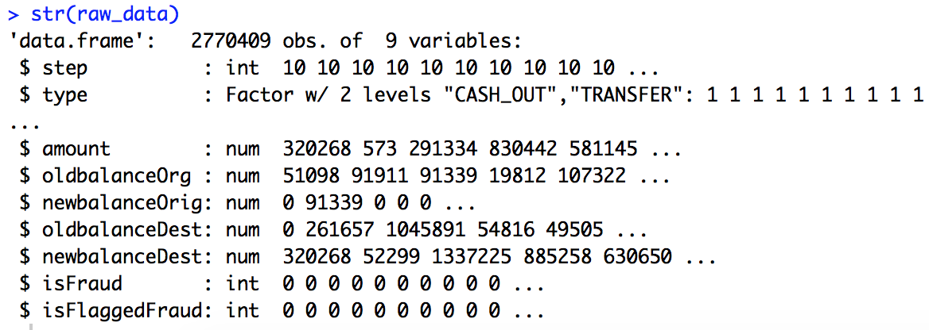
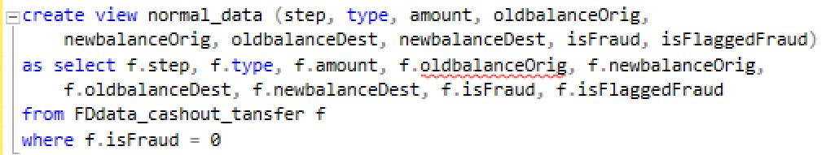
Data retrieving

Slide 11
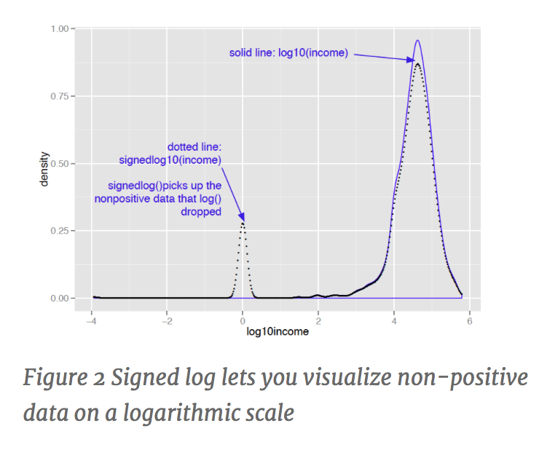
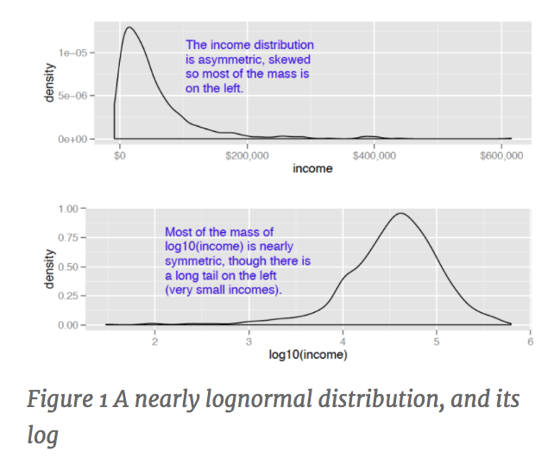
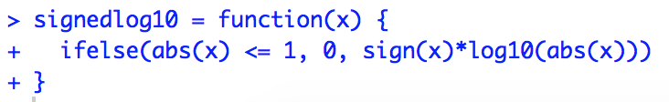
Monetary Data normalization
Notes:
monetary amounts are often lognormally distributed—that is, the log of the data is normally distributed. This leads us to the idea that taking the log of the data can restore symmetry to it.
I like to use log base 10 for monetary amounts, because orders of ten seem natural for money: $100, $1000, $10,000, and so on. The transformed data is easy to read.
In applications where the skewed data is monetary (like account balances or customer value), I instead use what I call a “signed logarithm”. A signed logarithm takes the logarithm of the absolute value of the variable and multiplies by the appropriate sign. Values with absolute value less than one are mapped to zero. The difference between log and signed log are shown in figure 2.
Clearly this isn’t useful if values below unit magnitude are important. But with many monetary variables (in US currency), values less than a dollar aren’t much different from zero (or one), for all practical purposes. So, for example, mapping account balances that are less than a dollar to $1 (the equivalent every account always having a minimum balance of one dollar) is probably okay.

Slide 12
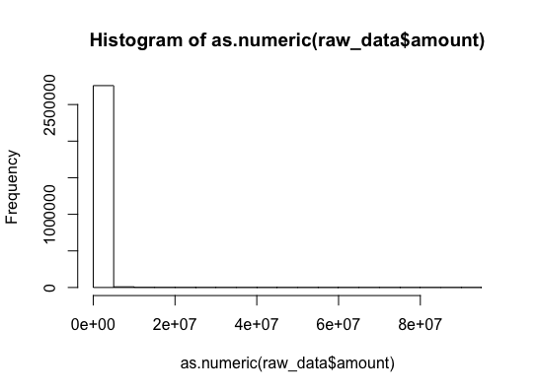
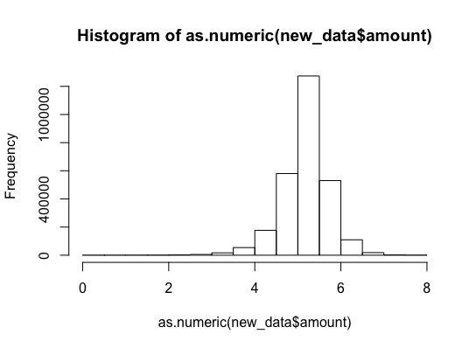
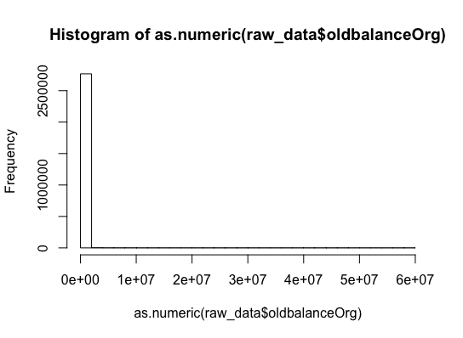
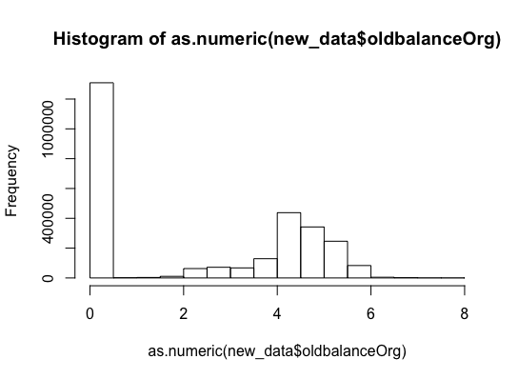

Slide 13
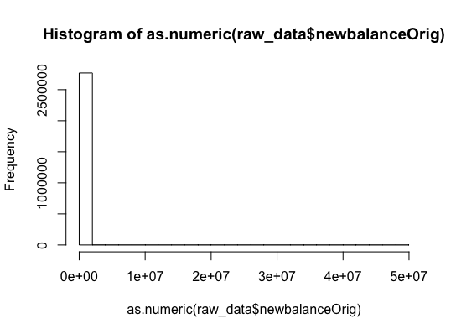
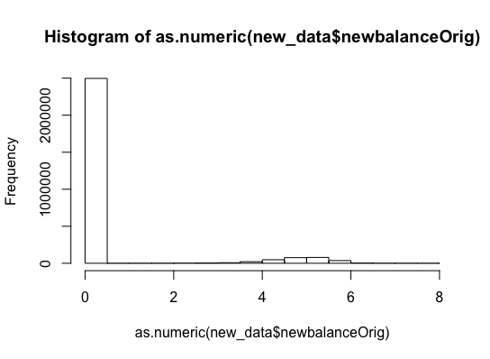
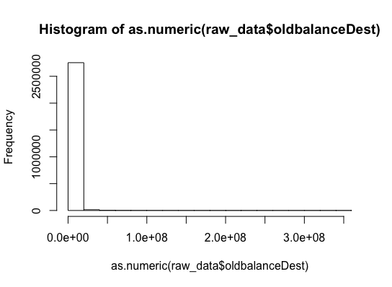
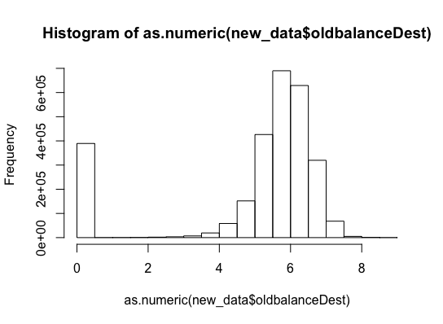

Slide 14

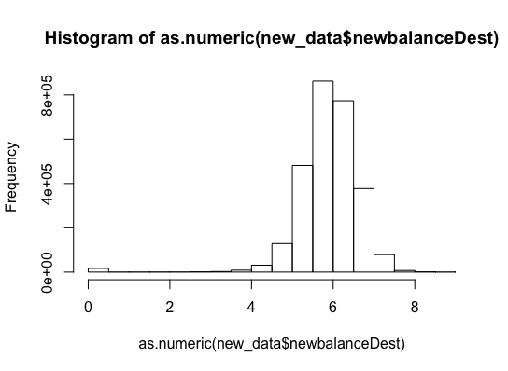
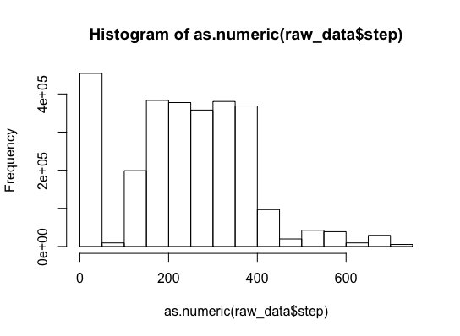
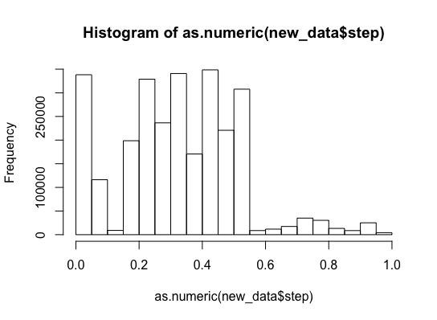

Slide 15
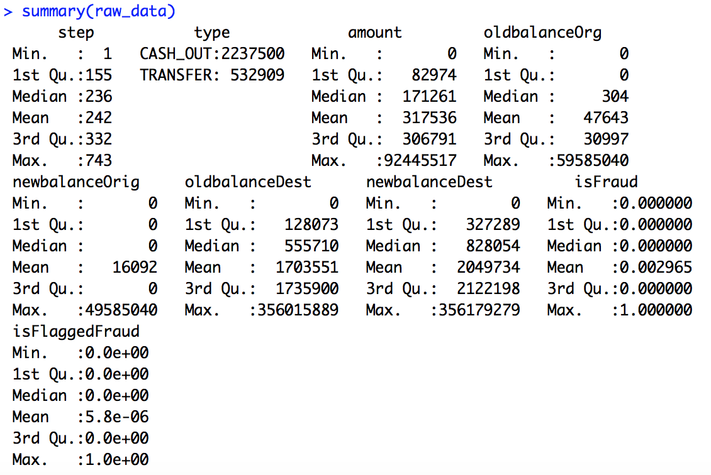
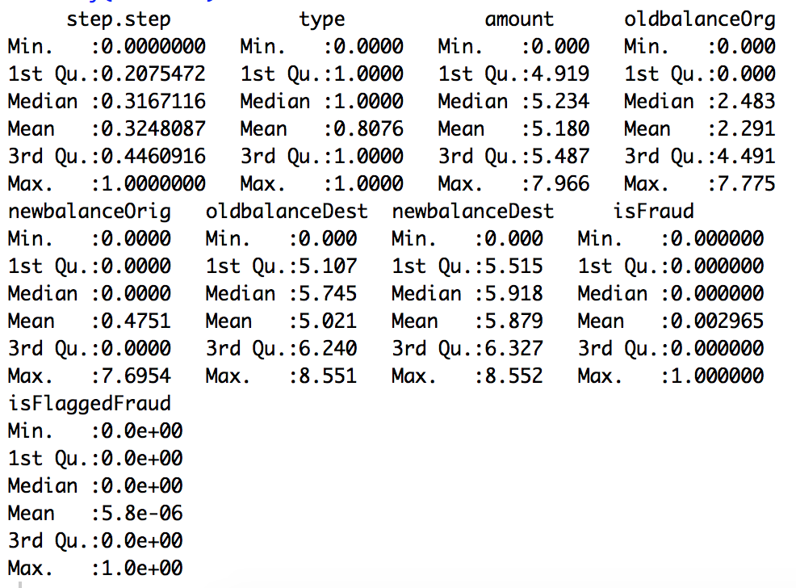
Summary of data before and after normalization
BEFORE
AFTER

Slide 16
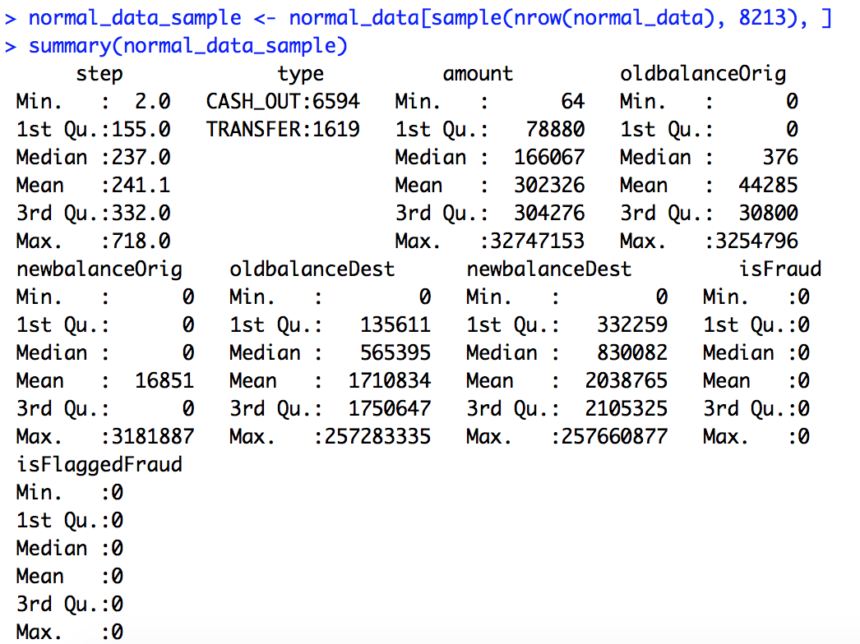
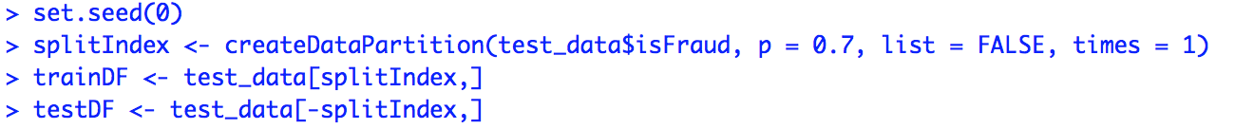
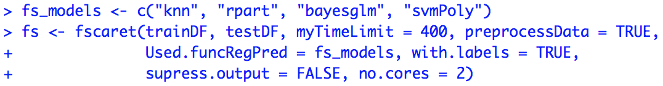
Procedures of Feature Selection
Sampling and normalization
Split testing and training set
Apply function
Notes:
Under-sampling of normal data, combine the sampled normal data with fraud data to balance the data set

Slide 17
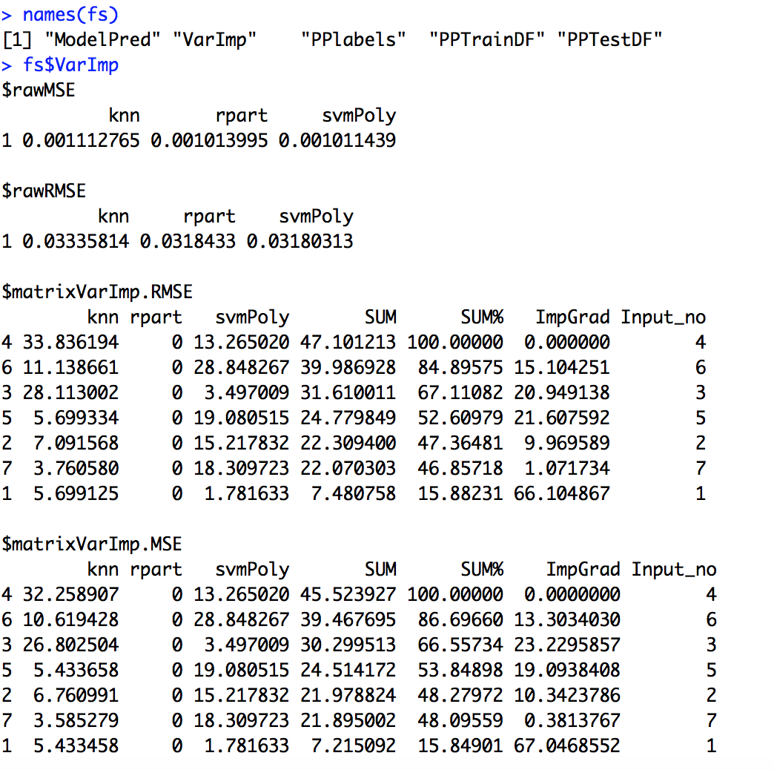
Result after running fscaret for feature selection
Notes:
deviation (RMSD) or root-mean-square error (RMSE) is a frequently used measure of the differences between values (sample and population values) predicted by a model or an estimator and the values actually observed.
MSE: In statistics, the mean squared error (MSE) or mean squared deviation (MSD) of an estimator (of a procedure for estimating an unobserved quantity) measures the average of the squares of the errors or deviations—that is, the difference between the estimator and what is estimated.
1) select the top features, for example, loop through the features in this order, eliminate one at a time and see what composition of features give the best result.
2)The result gives us some hints on using ensemble. We can compare the result of knn and svmPoly and see the MSE given by different features are quite different, so these two may work really work together in an ensemble to predict the data. Otherwise if two models give very similar result, using two in an ensemble is a bit of a waste.

Slide 18
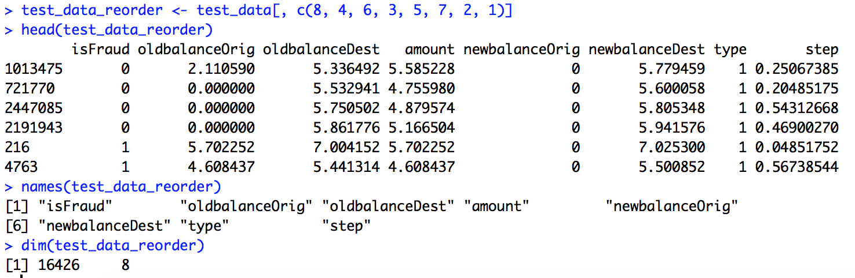
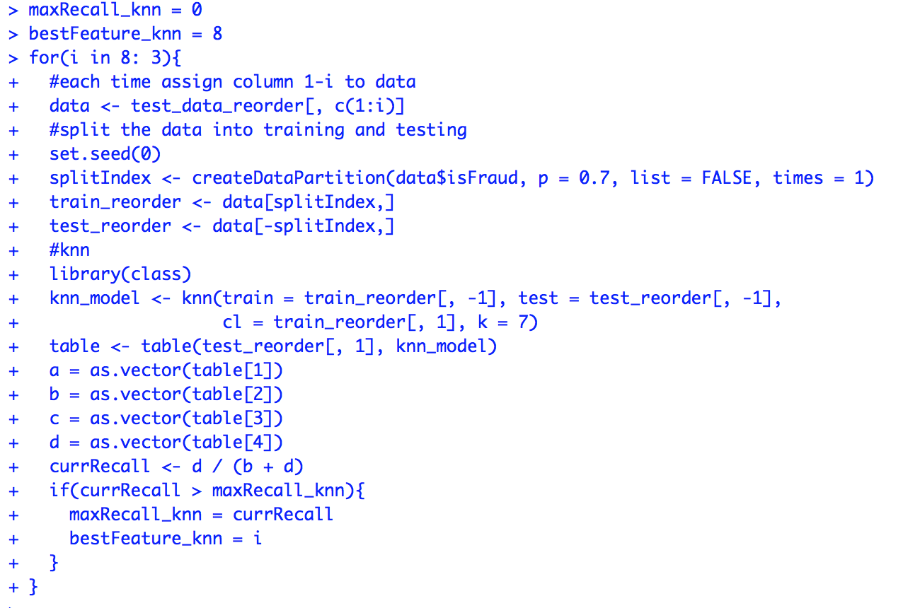
Use the order of feature importance to evaluate important features
Reorder the features
Loop through the features from the least important one

Slide 19
Comparison of feature selection results by using three classification methods
knn
0.995
5
C50
0.994
8
CART
0.991
5
"isFraud” "oldbalanceOrig" "oldbalanceDest" "amount" "newbalanceOrig"
"isFraud" "oldbalanceOrig" "oldbalanceDest" "amount" "newbalanceOrig" "newbalanceDest" "type" "step"
"isFraud” "oldbalanceOrig" "oldbalanceDest" "amount" "newbalanceOrig"
Recall value
Number of features
features

Slide 20
Decision Tree Classifier: CART
Notes:
A decision tree is a decision support tool that uses a tree-like graph or model of decisions and their possible consequences, including chance event outcomes, resource costs, and utility. It is one way to display an algorithm.
Classification And Regression Tree (CART)

Slide 21
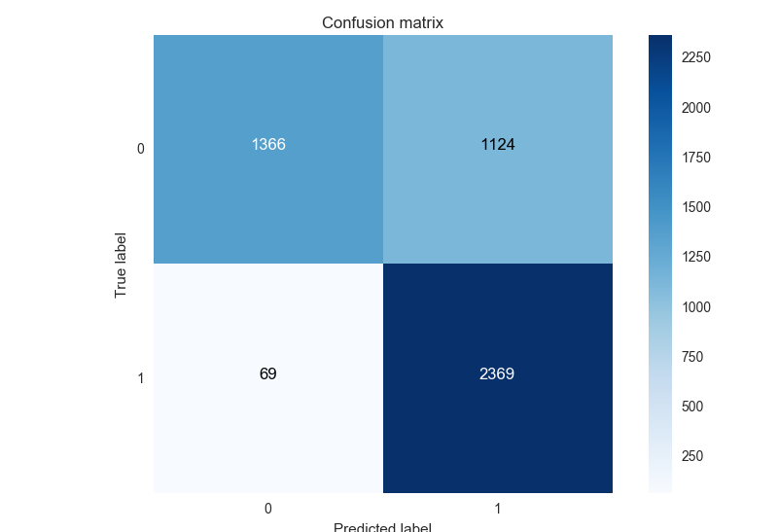
Decision Tree Classifier: CART

Slide 22
Decision Tree Classifier: Comparison
 | Base Model: default tree (CART) | Tree with best parameter setting (CART) | Random Forest with best parameter setting | Gradient boosting with best parameter setting
Recall Score | mean: 0.989 | mean: 0.994 | mean: 0.996 | mean: 0.996

Slide 23
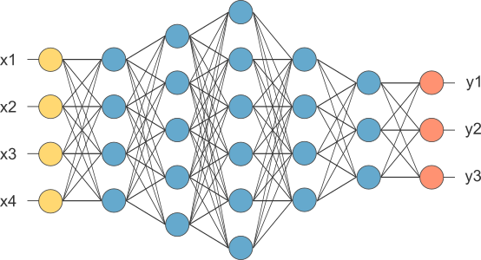
Neural Network
Notes:
We start with random connection weights, then for a given set of inputs, we decided on a set of desired outputs.
Using the random weights, we first let the network calculate some outputs, then we compare the output to the defined output.
So we find the difference, which is called error. Now we adjust the connection weights to reduce errors using backpropagation.

Slide 24
Neural Network: Data Preprocessing
Create one binary variable for each class label
Rescale continuous features to 0~1 range for better convergence
Split all the data into training set, validation set, and testing set at ratio 7: 1.5 : 1.5
Notes:
Training Set: this data set is used to adjust the weights on the neural network.
Validation Set: this data set is used to minimize overfitting. You're not adjusting the weights of the network with this data set, you're just verifying that any increase in accuracy over the training data set actually yields an increase in accuracy over a data set that has not been shown to the network before, or at least the network hasn't trained on it (i.e. validation data set). If the accuracy over the training data set increases, but the accuracy over then validation data set stays the same or decreases, then you're overfitting your neural network and you should stop training.
Testing Set: this data set is used only for testing the final solution in order to confirm the actual predictive power of the network.

Slide 25
Neural Network: Architecture
One input layer. The number of neurons comprising the layer is equal to the number of features in the data (= 6)
One output layer. It has one node per class label—a total of 2 neurons. So softmax function is used for it.
4 hidden layers. Clearly, the data is not linearly separable. We need hidden layers. Picking 4 layers may not improve performance much, but will not hurt either.

Slide 26
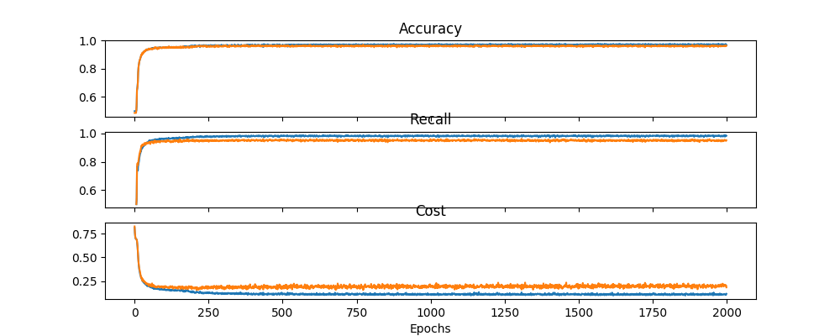
Neural Network: Architecture
Notes:
an "epoch" describes the number of times the algorithm sees the ENTIRE data set.
The best weights based on the validation recall score during all 2000 epochs was saved. Then these weights were restored to test the test set.

Slide 27
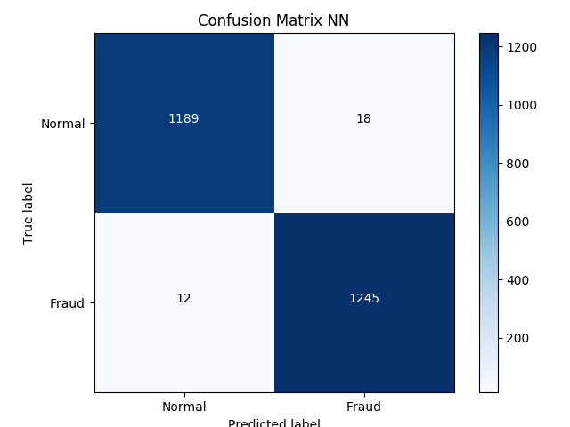
Neural Network: Results

Slide 28
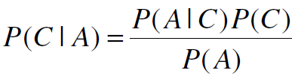
Naive Bayes Classifier
A probabilistic framework for solving classification problems
A family of simple probabilistic classifiers based on applying Bayes' theorem with strong (naive) independence assumptions between the features.
Bayes theorem:
Robust to isolated noise points
Handle missing values by ignoring the instance during probability estimate calculations
Robust to irrelevant attributes
Independence assumption may not hold for some attributes

Slide 29
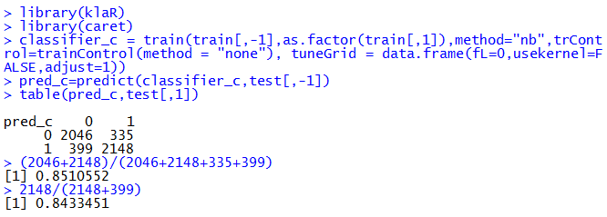
Naive Bayes Classifier
Use ' caret' to built Naive Bayes Classifier:

Slide 30
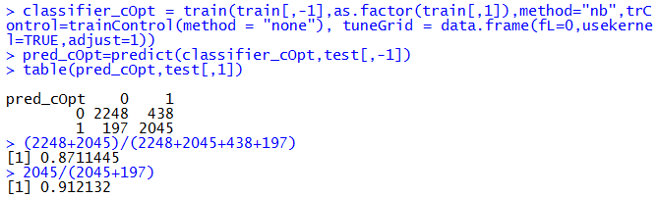
Naive Bayes Classifier
Based on the above result, we can use the parameters (fL = 0, usekernel = TRUE, adjust = 1) to build a better classifier
The accuracy is 0.8711445, recall score is 0.912132.
The result is better than before (0.8510552, 0.8433451).

Slide 31
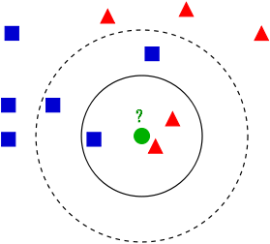
k-nearest neighbor classification
Notes:
k-nearest neighbor classification for test set from training set. For each row of the test set, the k nearest (in Euclidean distance) training set vectors are found, and the classification is decided by majority vote, with ties broken at random.
It is very straitforward

Slide 32
Procedure of k-nearest neighbor classification
Read preprocessed and normalized data from .csv file
Split training and testing data set
Loop through different k number to find the k
Knn method with cross-validation

Slide 33
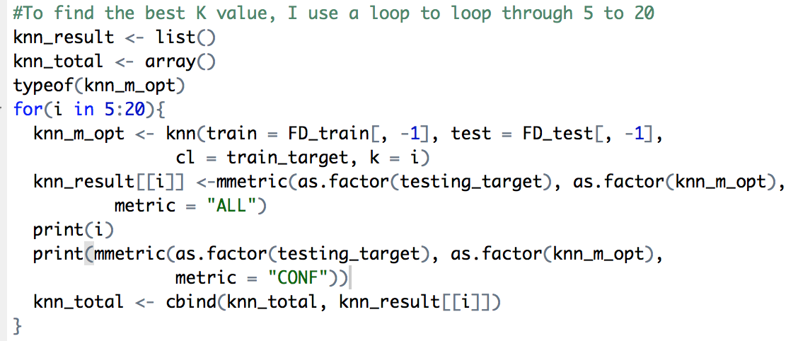
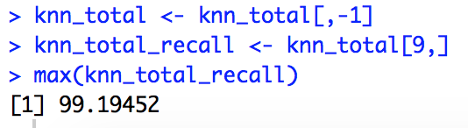
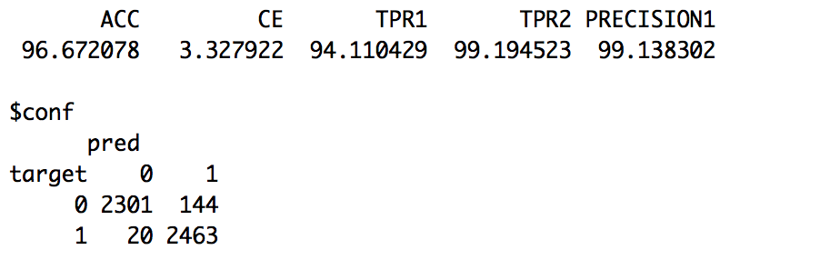
Find the best k number
Results and confusion table

Slide 34
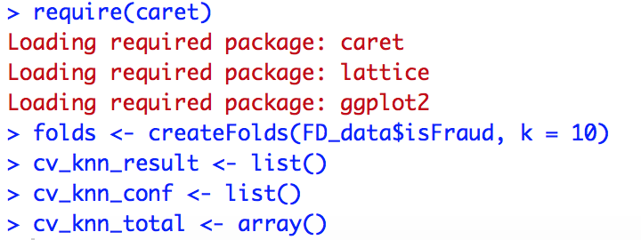
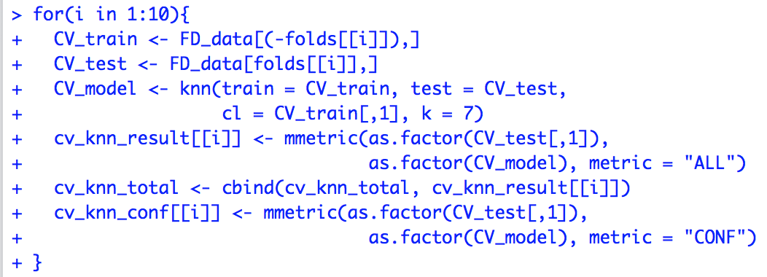
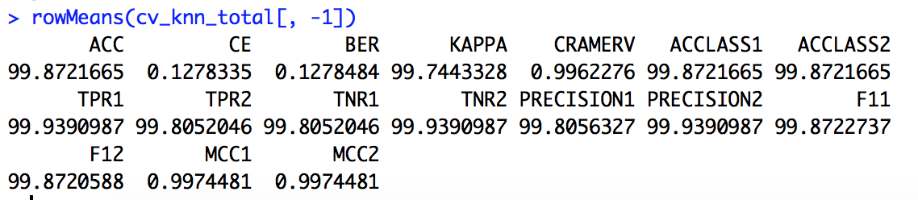
knn and Cross validation
Create the folds
Iterate 10 times
rowMeans of the metric after CV
Notes:
Using the k-nearest neighbor give an OK results to the balanced and normalized dataset. When k = 7 (7 neighbors were taken into consideration, the recall value is the smallest). The following shows the result and confusion table when k = 7. 20 cases which were fraud were predicted normal, which should be increased further, because the false-negative result could result in significant financial loss. In compensation, we do not care the false-positive result so much.

Slide 35
Model Evaluation
Metrics for Performance Evaluation: recall
Methods for Performance Evaluation: cross-validation
Model Comparison

Slide 36
Summary of classifiers
 | Base Model: default tree (CART) | Tree with best parameter setting (CART) | Random Forest with best parameter setting | Gradient boosting with best parameter setting | Neural Network
Recall | 0.989 | 0.994 | 0.996 | 0.996 | 0.9851
 | Naive Bayes | Support vector machine | Support vector machine with binarization | K-nearest neighbor with best k
Recall | 0.912 | 0.997 | 0.997 | 0.998
Notes:
After optimizing parameter setting, recall value improved
Using ensemble method (random forest and gradient boosting), recall value improved
Recall value in NN is not very good, however, the network greatly reduced the false negative, from thousands to less than 20, which is the best among all the classifiers
Naïve bayes does not perform very well, it works best with the independent attribute data set. And for the continuous data, it does not work so well.
Support vector machine has the best performance

Slide 37
Project review and outlook
The normalization methods (signedlog10) changed the skewed monetary data distribution really well.
Most classifiers gave more than 99% recall values, that be said, 20 out of 2500 cases were predicted to be false negative from our testing dataset.
CART, Random Forest , Gradient boosting, Support vector machine and K-nearest neighbor have similar performance whereas Naive Bayes is not so good for the dataset. NN reduced FN from thousands to 18.

Slide 38
Project review and outlook
After comparison of the performance of each classifier, more effort may be put in data sampling, because the data is very skewed (2.7M normal data VS 8k fraud data). The effect of outliers may be phenomenal if we only sample once.
Feature selection shows that eliminating some features which we thought they are important intuitively actually gives better results, some as “newbalanceDest”.
We should be aware of that , in real life, the fraud detection requires much more dimensions and depths of data than the synthetic dataset, for example, user’s social network information (text mining).

Slide 39
Thanks!

